Slide 1
Martin Setvák CHMI Satellite Department
web: http://www.chmi.cz, http://www.setvak.cz
e-mail: martin.setvak@chmi.cz, setvak@gmail.com
A satellite perspective on interactions between convective storms and the upper atmosphere
Co-authors: Steven Miller, Steven.Miller@colostate.edu Cooperative Institute for Research in the Atmosphere (CIRA), Colorado State University, Fort Collins, USA
Xavier Calbet, xcalbeta@aemet.es Agencia Estatal de Meteorología (AEMET), Madrid, Spain
European Conference on Severe Storms 2019, Krakow, Poland
4 – 8 November 2019

Slide 2
Abstract
By the end of 1980’s, convective storms had been identified as the principal source of concentric gravity waves (CGW), occasionally manifesting as modulations to atmospheric nightglow near the mesopause (at about 85-100km levels). Since then, various methods of gravity wave detection in the upper stratosphere and mesosphere have significantly evolved and improved, including satellite observations. Among the latter, nocturnal low-light observations by Day/Night Band (DNB) of the Suomi-NPP and NOAA-20 (JPSS-1) satellites, and observations by hyperspectral sounders such as AIRS (aboard Aqua satellite) and IASI (on Metop), have begun to revolutionize the way we are able to observe and characterize this important atmospheric energy transfer mechanism.
This work focuses on DNB observations of CGW (generated by convective storms) in nightglow emissions, and preliminary statistics of their global occurrence. To date, we have collected about 100 worldwide CGW cases (2014/4 cases, 2015/13 cases, 2016/14 cases, 2017/33 cases, and 2018/48 cases). While the cases during 2014 – 2016 were gathered unmethodically (based on scrutiny of DNB imagery in correlation with deep convection as identified in various infrared band imagery), the cases from 2017 and 2018 result from a global systematic survey of NPP-DNB imagery, available through NASA’s EOSDIS Worldview service since December 2016. The majority of these cases come from north subtropics of Africa (56 cases), followed by Australia (16 cases), Mediterranean (11 cases), Argentina (7 cases), and the remainder coming from elsewhere. However, these numbers are compromised and biased by a significant non-meteorological factor: heavy light pollution in some of the otherwise storm-rich areas, such as the U.S. or China, where the bright background adversly impacts DNB-based CWG detection.
Besides the statistics above, we will present some of the characteristics of CGW seen by the DNB in nightglow, including typical horizontal wavelengths (resolved by the 0.74 km pixel resolution of the DNB) and their horizontal extent (reaching up to 2500-3000 km from their source in the most extreme cases). For selected cases mentioned above we will also present their corresponding manifestation in AIRS and IASI data, which show the CGW at lower altitudes than DNB, in the upper stratosphere (at about 40km). This analysis yields the first basic statistics on the simultaneous occurrence of CGWs spanning the stratosphere through the mesosphere. As such, this study illustrates the promising potential of multisensor observations of CWG throughout the middle atmosphere at spatial and temporal resolutions previously unavailable at the global scale.
Martin Setvák (CHMI)

Slide 3
Satellite observations of atmospheric gravity waves, generated by convection
Observations in visible, near-IR and IR bands (e.g. AVHRR, MODIS, VIIRS, SEVIRI, ABI, …) of various forms of gravity waves at cloud tops of convective storms; features related to gravity wave breaking mechanism, observed at or just above the storm tops – jumping cirrus, above anvil cirrus plumes, „radial cirrus”, etc. Various forms of gravity waves in WV absorption bands accompanying storm activity. All of these closely related to / initiated by strong updrafts, manifested by overshooting tops. Typically at levels 8 – 14 km (at mid-latitudes), near the tropopause and in lowest layers of the stratosphere.
Atmospheric gravity waves in AIRS (Atmospheric Infrared Sounder, Aqua satellite) and IASI (Infrared Atmospheric Sounding Interferometer, Metop 1 – 3 satellites) hyperspectral sounding data, in the upper stratosphere (~ 40 km).
Concentric gravity waves (CGW) observed in nighttime by the Suomi-NPP and NOAA-20 satellites in their Day/Night Band (DNB) data, high above convective storms, in the airglow (nightglow), at 85 – 100 km (near the mesopause).
Martin Setvák (CHMI)

Slide 4
Satellite observations of atmospheric gravity waves, generated by convection
Observations in visible, near-IR and IR bands (e.g. AVHRR, MODIS, VIIRS, SEVIRI, ABI, …) of various forms of gravity waves at cloud tops of convective storms; features related to gravity wave breaking mechanism, observed at or just above the storm tops – jumping cirrus, above anvil cirrus plumes, „radial cirrus”, etc. Various forms of gravity waves in WV absorption bands accompanying storm activity. All of these closely related to / initiated by strong updrafts, manifested by overshooting tops. Typically at levels 8 – 14 km (at mid-latitudes), near the tropopause and in lowest layers of the stratosphere.
Atmospheric gravity waves in AIRS (Atmospheric Infrared Sounder, Aqua satellite) and IASI (Infrared Atmospheric Sounding Interferometer, Metop 1 – 3 satellites) hyperspectral sounding data, in the upper stratosphere (~ 40 km).
Concentric gravity waves (CGW) observed in nighttime by the Suomi-NPP and NOAA-20 satellites in their Day/Night Band (DNB) data, high above convective storms, in the airglow (nightglow), at 85 – 100 km (near the mesopause).
Martin Setvák (CHMI)

Slide 5
Primary goals of this study
DNB observations of concentric gravity waves (CGW) generated by convective storms in nightglow emissions, statistics of their occurrence on global scale,
basic characteristics of these CGW (horizontal extent, typical wavelengths, … ),
for all cases of CGW detected in DNB, their manifestation in the AIRS data
for selected cases of CGW detected in DNB, their manifestation in IASI data.
Martin Setvák (CHMI)

Slide 6
Airglow (nightglow) and the VIIRS Day/Night Band
VIIRS Day/Night band range (0.5 – 0.9 µm)
Image source: http://www.atoptics.co.uk/highsky/airglow2.htm
Airglow sources – processes related to de-excitation of atoms and molecules, excited by solar ultraviolet radiation during the daytime hours, including chemiluminescence. In contrast to aurora, airglow can be observed globally.
blue – molecular oxygen, ~ 95 km
green – atoms of oxygen (557.7 nm), 90 – 100 km
yellow – sodium atoms (589 nm, meteorite origin, or possibly sea salt), ~ 92 km
red – atoms of oxygen (630, 636.4 nm), 150 – 300 km
red and near IR range – hydroxyl radicals (OH), 85 – 90 km
Given the broadband nature of the VIIRS Day/Night Band, it is not possible to make any inferences about wavelengths of the airglow features observed in this band, and neither about the height of these. All spectral lines between 0.5 and 0.9 µm and airglow layers are superimposed in DNB images. As the emissions at 150-300 km are much weaker compared to those originating between 85 – 100 km, all nightglow features observed in DNB imagery are located at 85 – 100 km, near the mesopause.
Martin Setvák (CHMI)

Slide 7
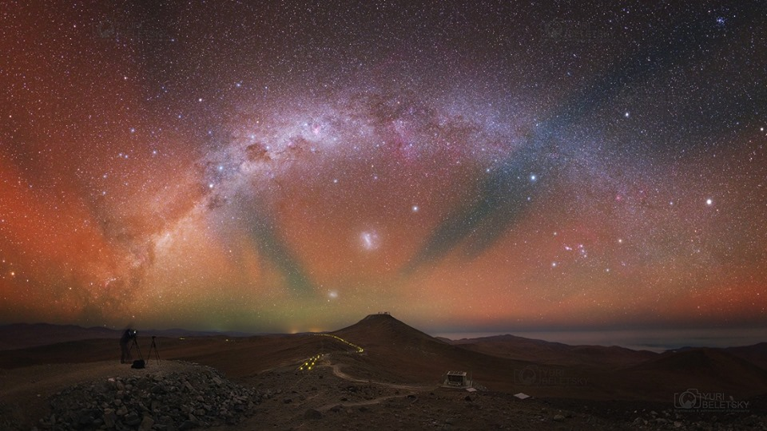
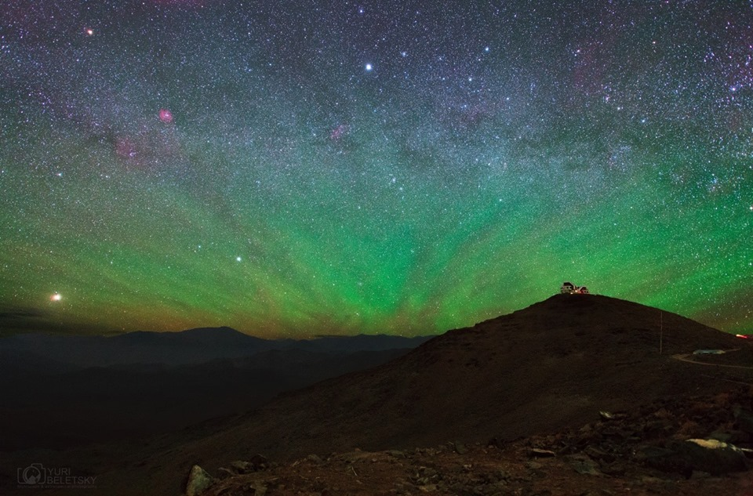
Example of nocturnal airglow (nightglow) in ground-based photos
Hydroxyl emissions (red and NIR, 85-90 km)
Oxygen 557.7 nm emission (green, 90-100 km)
Yuri Beletsky, 2015/2016, Chile, www.facebook.com/yuribeletskyphoto, www.instagram.com/yuribeletsky/
Martin Setvák (CHMI)

Slide 8
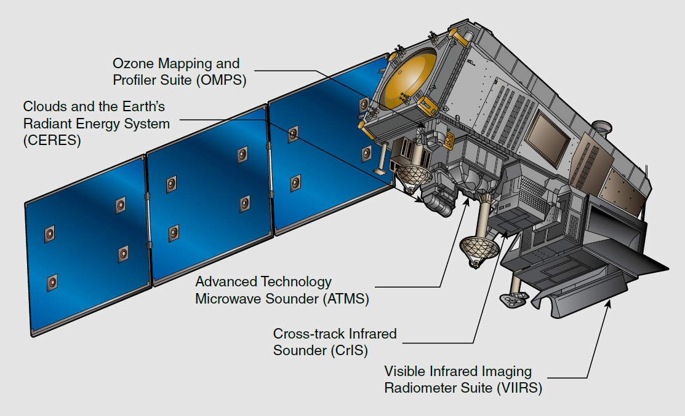
SNPP and JPSS (Joint Polar Satellite System) satellites
Suomi-NPP (SNPP) – 2011-10-28
JPSS-1 / NOAA 20 – 2017-11-18
JPSS-2 ~ 2022
JPSS-3 ~ 2026
JPSS-4 ~ 2031
NOAA-20 on the same orbit as SNPP, half orbit behind, ~ 50 minutes later
Visible Infrared Imaging Radiometer Suite (VIIRS)
Advanced Technology Microwave Sounder (ATMS)
Cross-track Infrared Sounder (CrIS)
Ozone Mapping and Profiler Suite (OMPS)
Clouds and the Earth's Radiant Energy System (CERES)
Martin Setvák (CHMI)

Slide 9
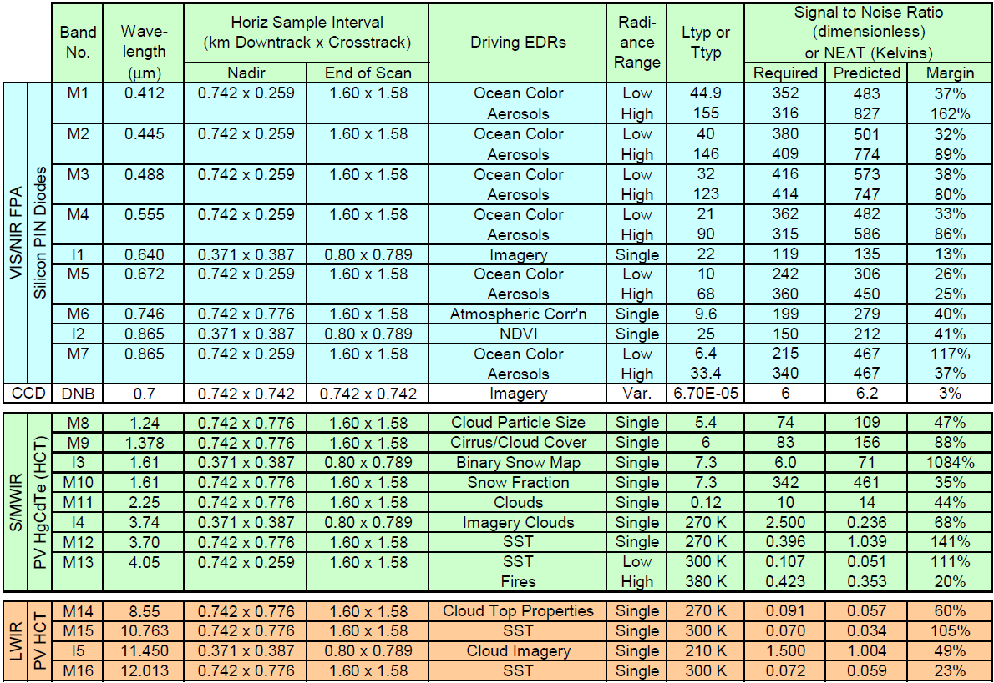
VIIRS (Visible Infrared Imaging Radiometer Suite) – Day/Night Band (DNB)
Total of 22 spectral bands:
resolution
I bands – 375 m (5)
M bands – 750 m (16)
DNB band – 750 m (1)
Day/Night Band (DNB)
Martin Setvák (CHMI)

Slide 10
Detailed information about the VIIRS Day-Night Band (DNB) and its nightglow observations:
Miller, Steven D., Cynthia L. Combs, Stanley Q. Kidder, Thomas F. Lee, 2012: Assessing Moonlight Availability for Nighttime Environmental Applications by Low-Light Visible Polar-Orbiting Satellite Sensors. J. Atmos. Oceanic Technol., 29, 538–557. doi: http://dx.doi.org/10.1175/JTECH-D-11-00192.1
Miller, S.D., Mills, S.P., Elvidge, C.D., Lindsey, D.T., Lee, T.F., Hawkins, J.D., 2012: Suomi satellite brings to light a unique frontier of nighttime environmental sensing capabilities. PNAS, vol. 109 no. 39, 15706–15711. doi: 10.1073/pnas.1207034109 (see also the supporting information of this paper)
Miller, S.D., Straka, W., III, Mills, S.P., Elvidge, C.D., Lee, T.F., Solbrig, J., Walther, A., Heidinger, A.K., Weiss, S.C., 2013: Illuminating the Capabilities of the Suomi National Polar-Orbiting Partnership (NPP) Visible Infrared Imaging Radiometer Suite (VIIRS) Day/Night Band. Remote Sens. 2013, 5, 6717-6766. doi: 10.3390/rs5126717
Miller, S.D., Straka W.III., Yue J., Smith, S.M., Alexander, J., Hoffmann, L., Setvák, M., and Partain, P.T., 2015: Upper atmospheric gravity wave details revealed in nightglow satellite imagery. PNAS 2015, vol.112, no.49, E6728–E6735. doi: 10.1073/pnas.1508084112
Martin Setvák (CHMI)

Slide 11
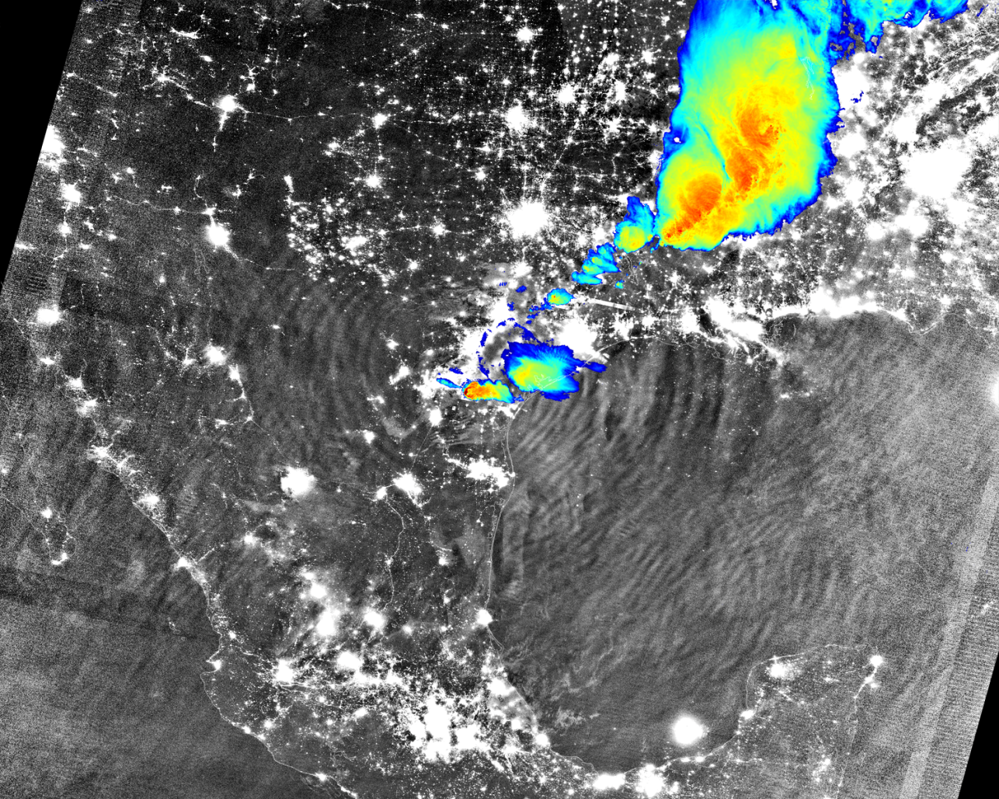
Example of concentric gravity waves in nightglow („classic“ case, above convective storms in Texas, 04 April 2014, 08:15 UTC)
Suomi-NPP Day/Night Band
and IR M15 band (190-240K)
Convectively-generated mesospheric airglow waves over Texas (CIMSS Satellite Blog)
http://cimss.ssec.wisc.edu/goes/blog/archives/15299
Severe Weather in the Mesosphere (VIIRS Imagery and Visualization Team Blog)
http://rammb.cira.colostate.edu/projects/npp/blog/index.php/uncategorized/severe-weather-in-the-mesosphere/
Martin Setvák (CHMI)

Slide 12
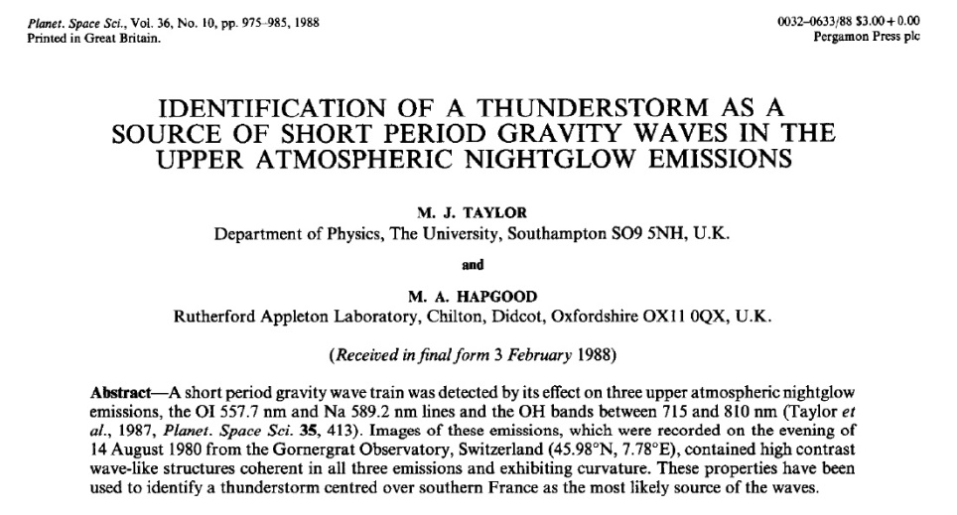
Concentric gravity waves (CGW) generated by convective storms
in nightglow (nocturnal airglow)
The concentric gravity waves (CGW) in nightglow are in most cases evoked by vertically propagating gravity waves generated by (stronger) convective storms, their updrafts / overshooting tops.
First unambiguously documented in
Taylor, M. J., and M. A. Hapgood, 1988: Identification of a thunderstorm as a source of short period gravity waves in the upper atmospheric nightglow emissions, Planet. Space Sci., 36, s.975. DOI:10.1016/0032-0633(88)90035-9
Recently, the source of these can be typically very easily traced, comparing the DNB images with IR bands or their combinations – either from the same satellite (same time and viewing geometry as the DNB image), or following the area of interest in geostationary IR image data (for information about evolution of the storms).
Martin Setvák (CHMI)

Slide 13
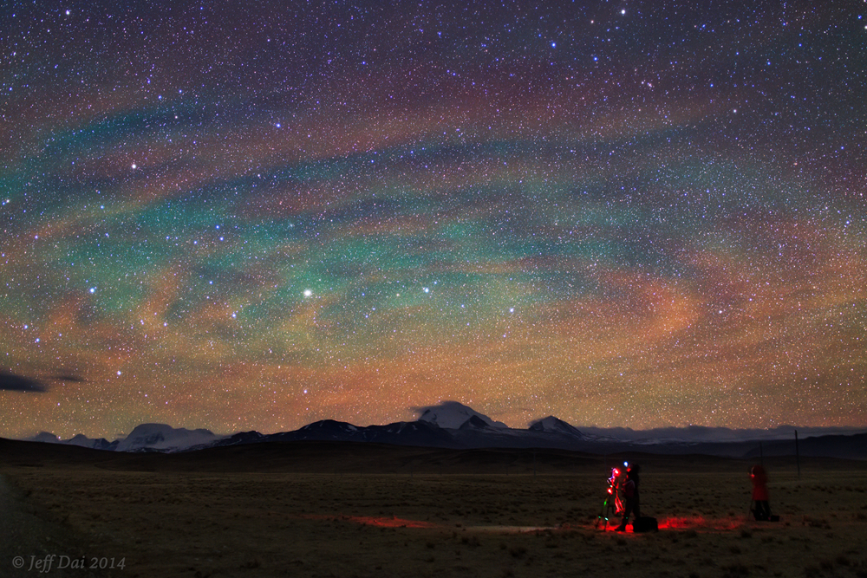
Concentric gravity waves in nightglow above Bangladesh, 27 April 2014
Jeff Dai, 2014-04-27 15:57 UTC, Tibet Plateau, China
https://www.flickr.com/photos/jeffdai/14845763849/
Martin Setvák (CHMI)

Slide 14
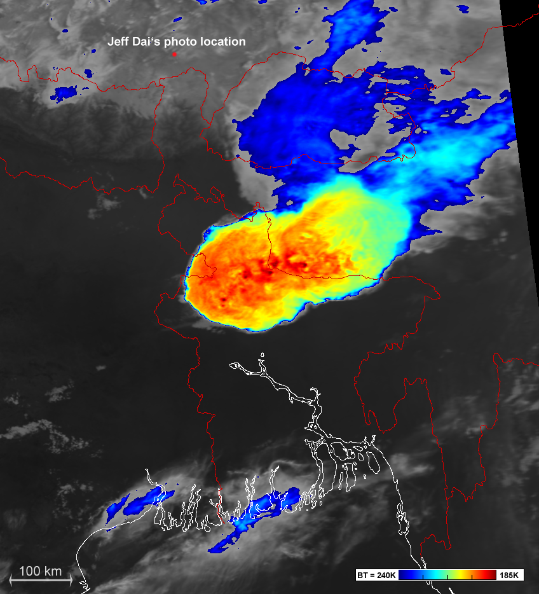
Concentric gravity waves in nightglow above Bangladesh, 27 April 2014
2014-04-27 15:50 UTC
Metop-2 band 4 (IR 10.5 µm)
This Metop-2 image was taken almost exactly at the same time as Jeff Dai took his famous "rippled sky" photo (previous slide) from the Tibetan Plateau in China.
This storm started to evolve about 1 hour prior to this image and Jeff Dai's observations. For evolution of these storms see the Meteosat-7 IR loop at the first of the links below.
Suomi-NPP VIIRS captured the waves in nightglow about 3.5 hours later, when the storms were already weakening (next 3 slides).
A Kalboishakhi storm swept across northern Bangladesh on the evening of 27 April 2014 (EUMETSAT Image Library)
http://www.eumetsat.int/website/home/Images/ImageLibrary/DAT_2204046.html
Rippled airglow above Bangladesh storms (EUMETSAT Image Library)
http://www.eumetsat.int/website/home/Images/ImageLibrary/DAT_2529304.html
Martin Setvák (CHMI)

Slide 15
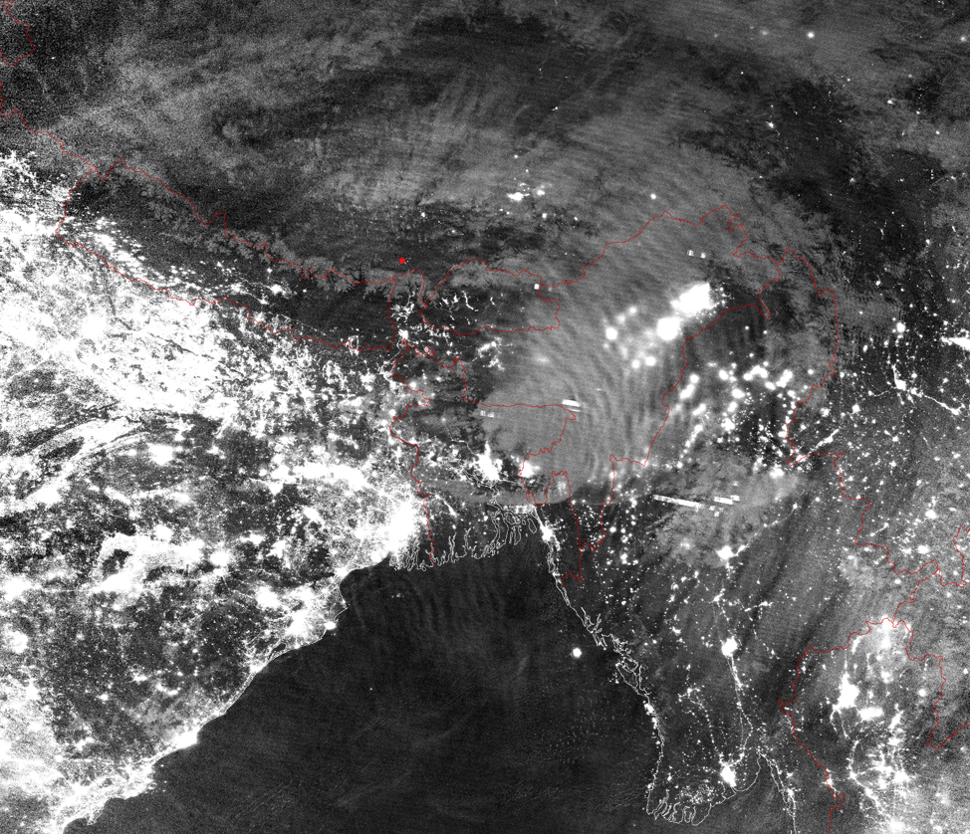
Concentric gravity waves in nightglow above Bangladesh, 27 April 2014
Suomi-NPP VIIRS
19:35 UTC
DNB image
Martin Setvák (CHMI)

Slide 16
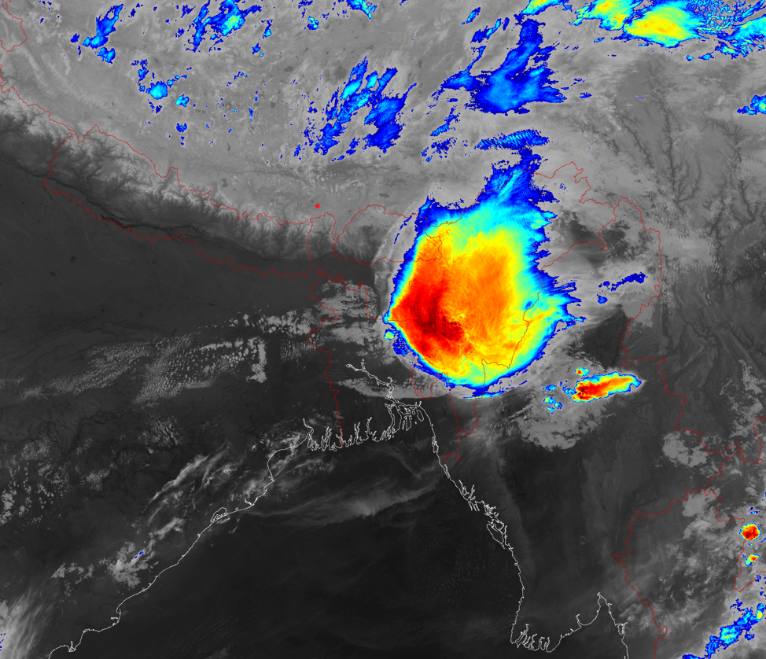
Concentric gravity waves in nightglow above Bangladesh, 27 April 2014
Suomi-NPP VIIRS
19:35 UTC
M15 (IR 10.7 µm)
BT 200 – 240 K
Martin Setvák (CHMI)

Slide 17
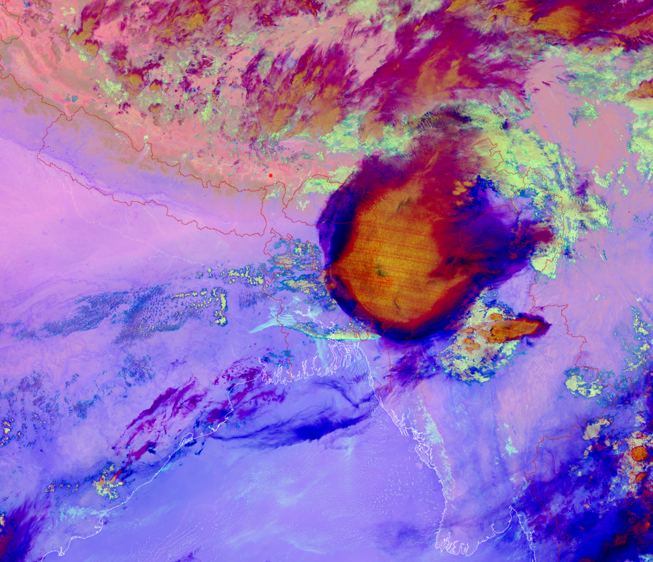
Concentric gravity waves in nightglow above Bangladesh, 27 April 2014
Suomi-NPP VIIRS
16:35 UTC
M12, M15 & M16 night microphysical
RGB product
Advantage of using similar RGB products as compared to single IR band images:
easier detection of low clouds above cold ground
easier detection of thin transparent cirrus
basic cloud microphysics interpretation
detection of dust storms in deserts and other arid areas
Martin Setvák (CHMI)

Slide 18
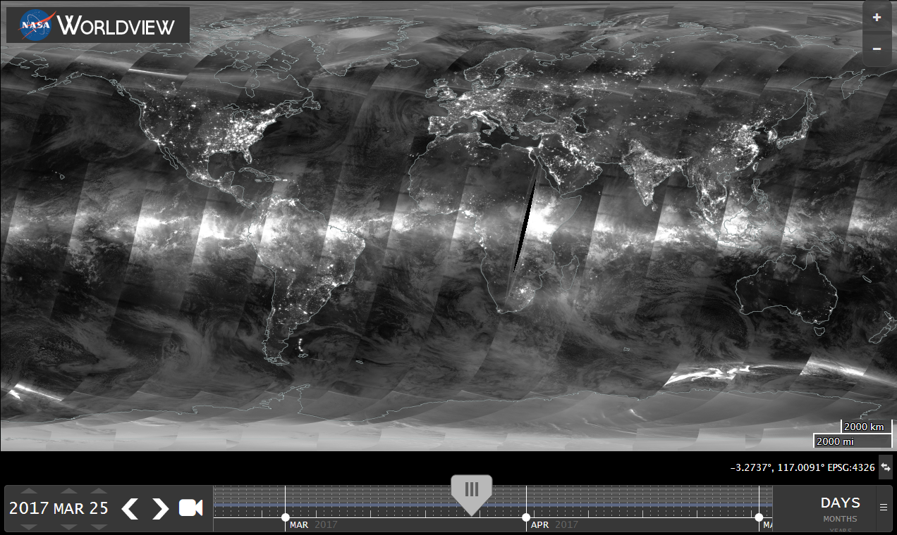
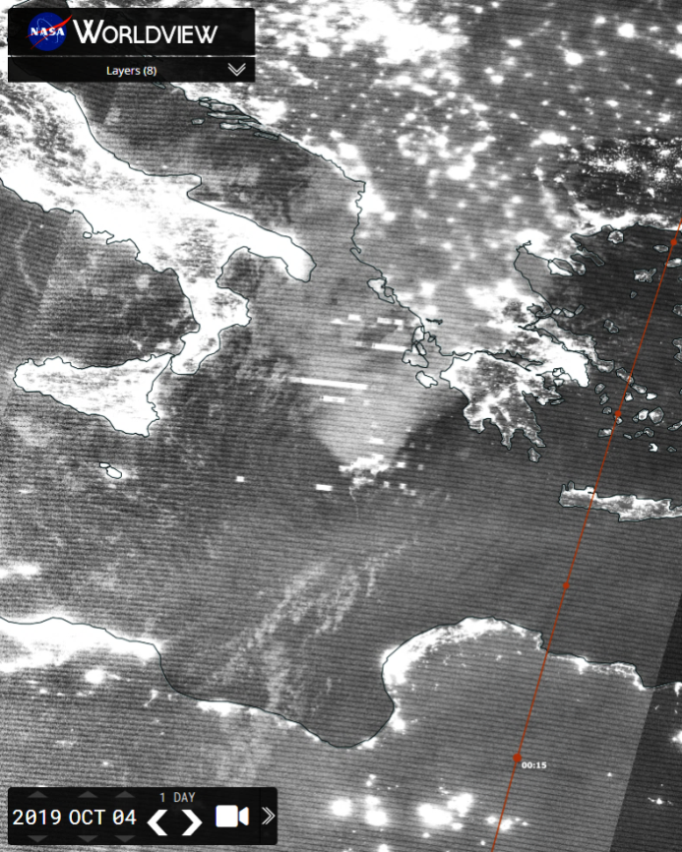
Nighttime DNB imagery @ NASA EOSDIS Worldview – from global scale to details of various local phenomena
NASA Worldview: worldview.earthdata.nasa.gov/
(DNB images available here since 30 November 2016)
Martin Setvák (CHMI)

Slide 19
Appearance of concentric gravity waves in nightglow, as observed in DNB
Big diversity of concentric gravity waves observed in nightglow, generated by convective storms:
young (fresh) CGWs … typically closed patterns (full „circle”), with well-defined individual waves, smaller horizontal extent, located above still active storm;
mature CGW … larger horizontal extent (up to ~ 2000 – 3000 km from the „parent” storm), waves closer to their source storm still well defined, while the older (?), more distant waves are beginning to fade out, mostly lower frequency, diffuse appearance;
old, dissipating waves – usually their parent storm already gone, without any well-defined CGW near the dissipating storm or its remains, diffuse appearance;
open versus closed patterns: most of mature or old CGW spreading into limited sectors only, with no wave patterns at one of its sides. Typical e.g. for storms at African northern subtropics – typically missing waves at more distant southern sector of these (towards the equator).
Martin Setvák (CHMI)

Slide 20
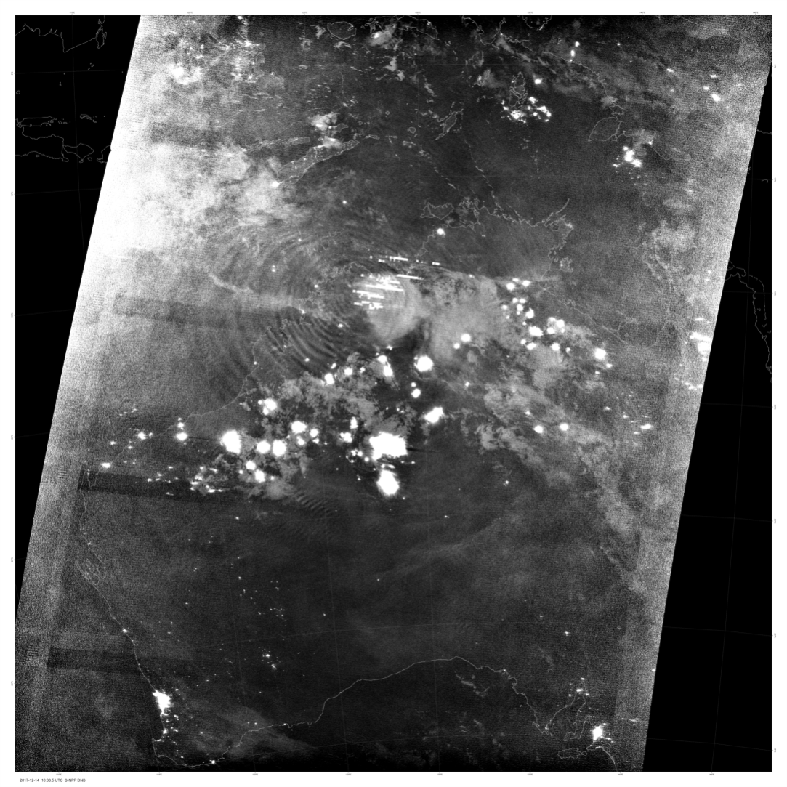
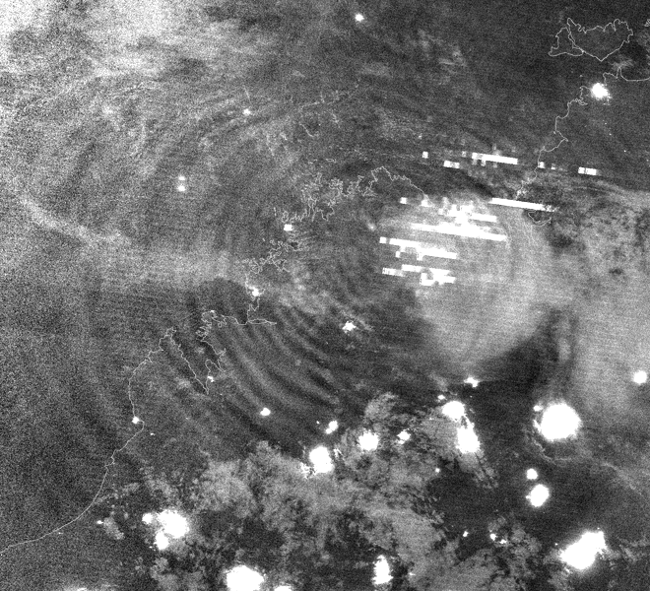
Examples of various forms of concentric gravity waves in nightglow, as observed in DNB
2017-12-14 16:38 UTC, Australia (S-NPP)
(zoom)
Martin Setvák (CHMI)

Slide 21
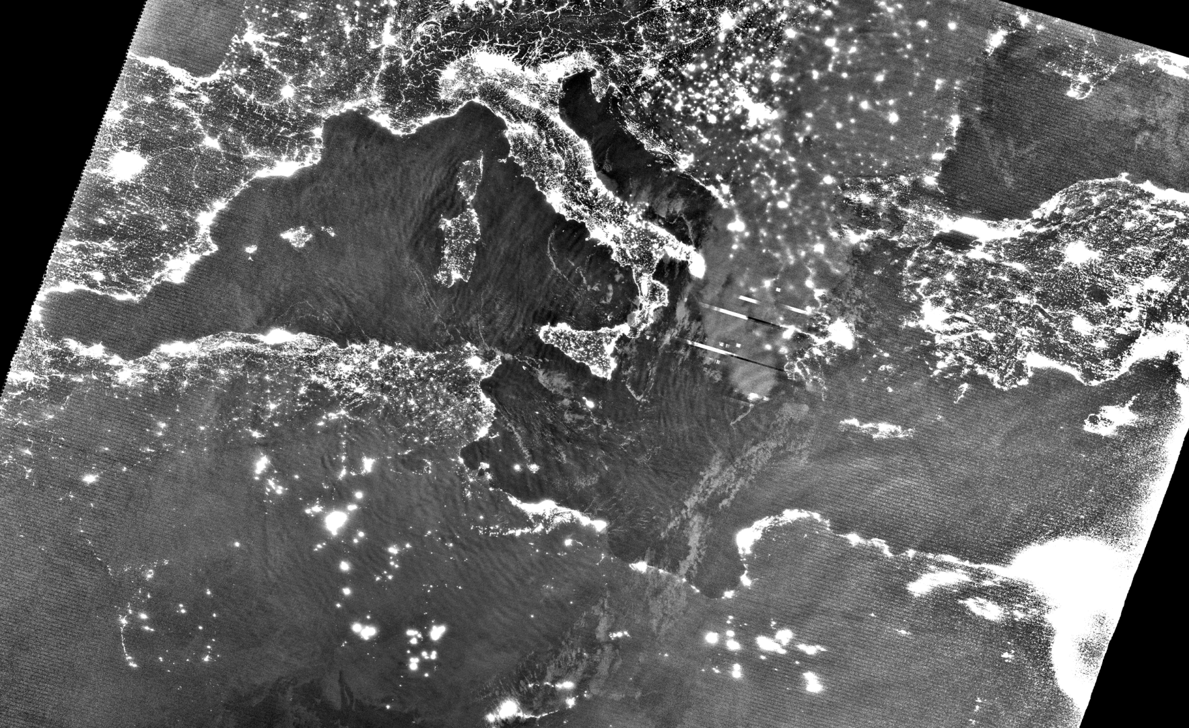
Examples of various forms of concentric gravity waves in nightglow, as observed in DNB
2019-10-04 01:03 UTC Mediterranean Sea NOAA-20
Martin Setvák (CHMI)

Slide 22
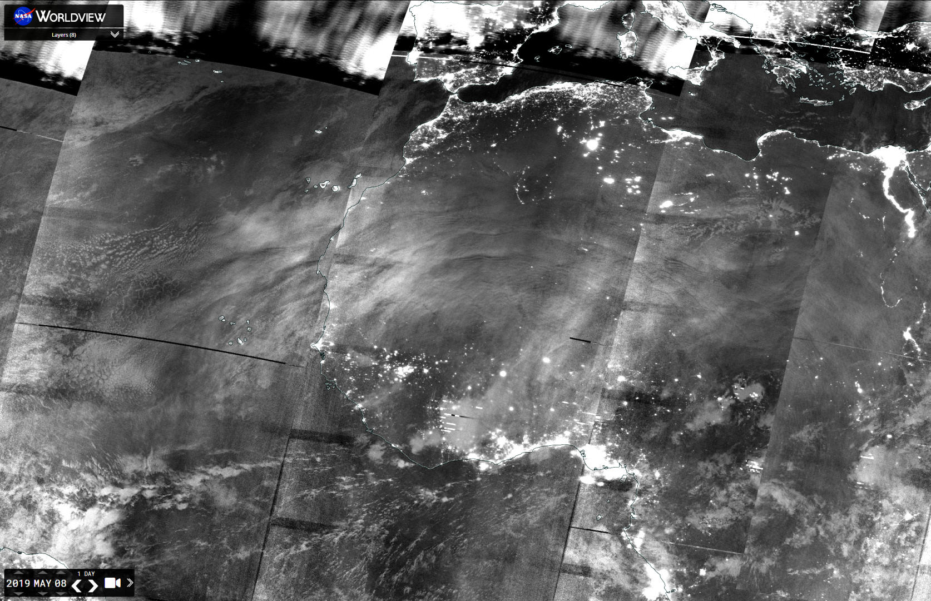
Examples of various forms of concentric gravity waves in nightglow, as observed in DNB
2019-05-08 00–03 UTC, NW Africa (S-NPP)
Martin Setvák (CHMI)

Slide 23
Possible interpretation problems and ambiguities when correlating the CGWs in nightglow (in DNB) with tropospheric phenomena (in the IR bands)
Parallax shift of the airglow features in DNB with respect to the ground or lower atmospheric layers (e.g. cloud tops of convective storms);
duration of vertical propagation of the gravity waves from their low-level sources up to the airglow layers – the source can move, weaken or even vanish before the gravity waves reach the airglow levels and modify them;
influence of stratosphere and mesosphere on storm-generated gravity waves during their propagation upwards – attenuation of the waves, their shift (vertical tilt), primary versus secondary GW, …
persistence of the airglow waves after decay of their source (e.g. convective storm) which has evoked these, combined with possible advection of the airglow layers and displacement of the source itself (e.g. propagation of the storms).
Lack of similar instrument in the GEO orbit – no space-borne, continuous information on evolution of CGW in nightglow and their variability throughout the whole night.
Martin Setvák (CHMI)

Slide 24
Summary of CGW cases detected in DNB (till 25 Oct 2019)
CGW (and partial CGW) detections in nightglow in VIIRS DNB data (Suomi-NPP and NOAA-20)
REGION | 2013-2016 | 2017 | 2018 | 2019 | total:
Mediterranean region (including all coastal areas) | 4 | 2 | 4 | 3 | 13
Africa (including east Atlantic, west Indian ocean) | 24 | 19 | 14 | 16 | 73
North America and NE Pacific | 1 | 5 | 0 | 6 | 12
South America and SE Pacific | 0 | 2 | 3 | 0 | 5
Australia (and adjacent seas/oceans) | 0 | 1 | 6 | 5 | 12
East Asia (east of India, and adjacent seas/oceans) | 2 | 0 | 2 | 3 | 7
SW Asia (incl. India and Arab Peninsula, and adj. seas/ocean) | 1 | 4 | 1 | 3 | 9
total: | 32 | 33 | 30 | 36 | 131
Geographical distribution of DNB CWG detections: most of these from north subtropics of Africa. However, the geographical distribution of DNB detections is strongly compromised and biased by a significant non-meteorological factor: heavy light pollution in some of the otherwise storm-rich areas, such as the U.S., Europe or China, where the bright background adversely impacts DNB-based CWG detection.
While the cases during 2013 – 2016 were gathered unmethodically (based on scrutiny of DNB imagery in correlation with deep convection as identified in the VIIRS and Meteosat Second Generation (MSG) infrared band imagery), the cases from 2017 – 2019 result from a global systematic survey of NPP DNB imagery, available through NASA’s EOSDIS Worldview service since 30 November 2016.
Martin Setvák (CHMI)

Slide 25
Gravity waves in AIRS data (Atmospheric Infrared Sounder, Aqua satellite)
Simultaneous observations of CGW observed in DNB (85–100 km) and AIRS 4.3 μm radiance (30-40 km) bands - namely above tropical cyclones, e.g.:
Jia Yue, Steven D.Miller, Lars Hoffmann, William C. StrakaIII, 2014: Stratospheric and mesospheric concentric gravity waves over tropical cyclone Mahasen: Joint AIRS and VIIRS satellite observations. http://dx.doi.org/10.1016/j.jastp.2014.07.003
Gong, Jie; Yue, Jia; and Wu, Dong L., 2015: Global survey of concentric gravity waves in AIRS images and ECMWF analysis. NASA Publications. Paper 157. http://digitalcommons.unl.edu/nasapub/157
L.Hoffmann, M.J.Alexander, C.Clerbaux, A.W.Grimsdell, C.I.Meyer, T.Rößler, and B.Tournier, 2014: Intercomparison of stratospheric gravity wave observations with AIRS and IASI. Atmos. Meas. Tech., 7, 4517–4537, 2014. doi:10.5194/amt-7-4517-2014
Our study: survey of all collected DNB-based CGW cases in nightglow for presence of corresponding (concentric) gravity waves in the AIRS data.
Simple approach – use of the original radiances only. Probably not as efficient as other, more advanced methods described in the studies above, but easy and fast.
Martin Setvák (CHMI)

Slide 26
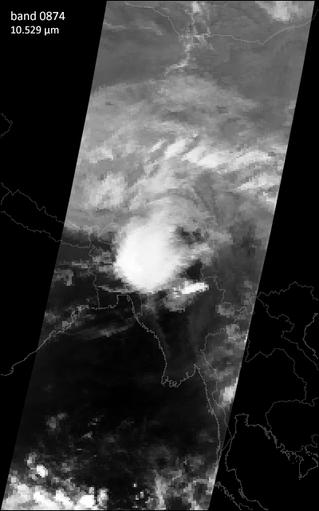
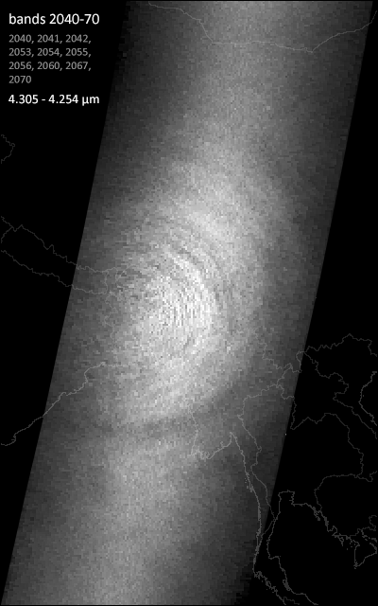
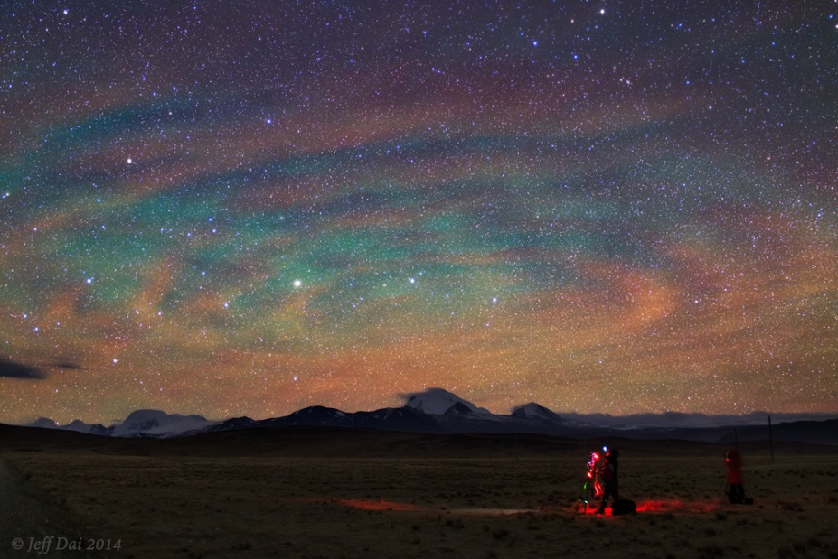
Example of concentric gravity waves in nightglow (left, ground-based photo), and in the upper stratosphere, in AIRS data (right)
Bangladesh, 27 April 2014
Jeff Dai, 2014-04-27 15:57 UTC, Tibet Plateau, China
https://www.flickr.com/photos/jeffdai/14845763849/
AIRS (Aqua) 19:29 – 19:41 UTC
Martin Setvák (CHMI)

Slide 27
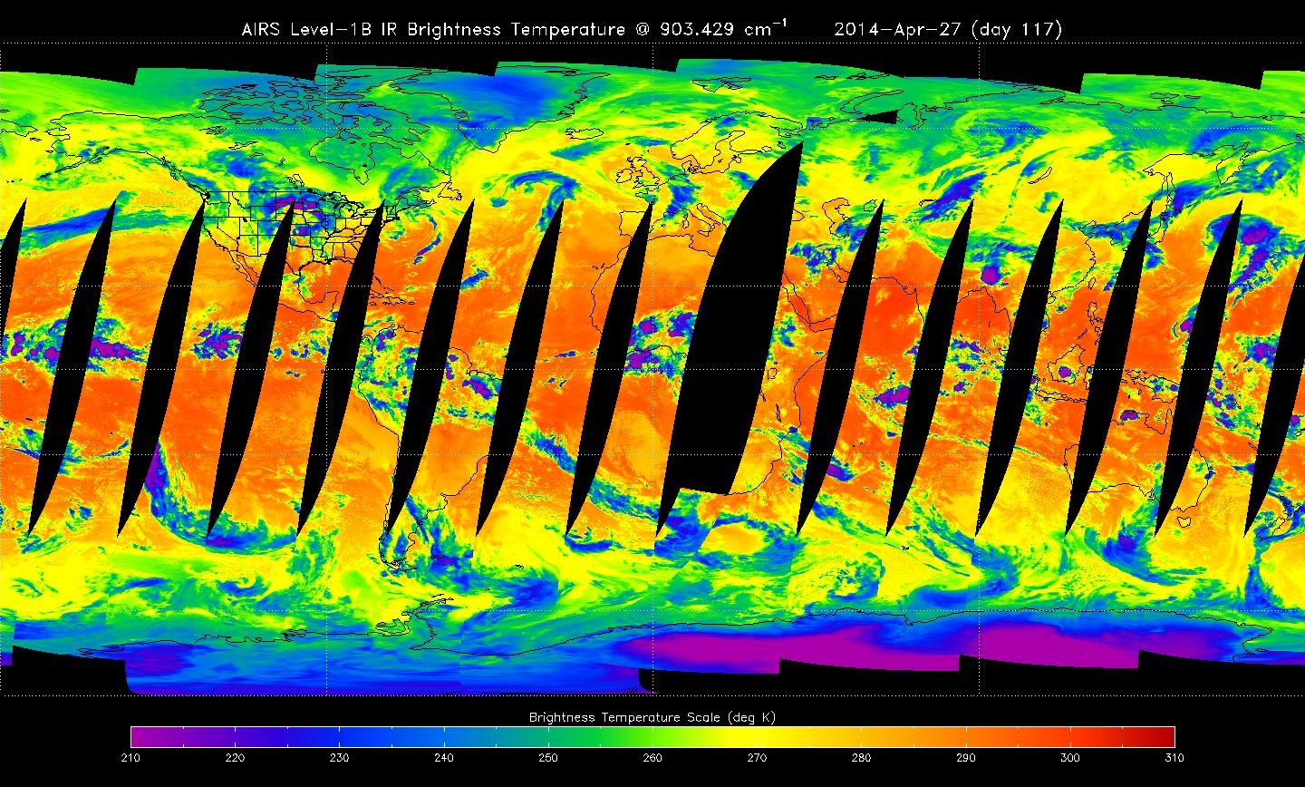
AIRS instrument (Atmospheric Infrared Sounder, Aqua satellite)
Example of AIRS daily L1B IR global coverage (descending passes)
AIRS sounder: 2378 individual bands
3.74 – 4.61 µm 6.20 – 8.22 µm 8.80 – 15.4 µm
swath width: 1650 km
IFOV 1.1° ~ 13.5 km footprint at nadir
Limited geographical coverage by AIRS data at lower latitudes – many of the DNB concentric GW cases either in the gaps between individual AIRS overpasses, or at their edge.
Martin Setvák (CHMI)

Slide 28
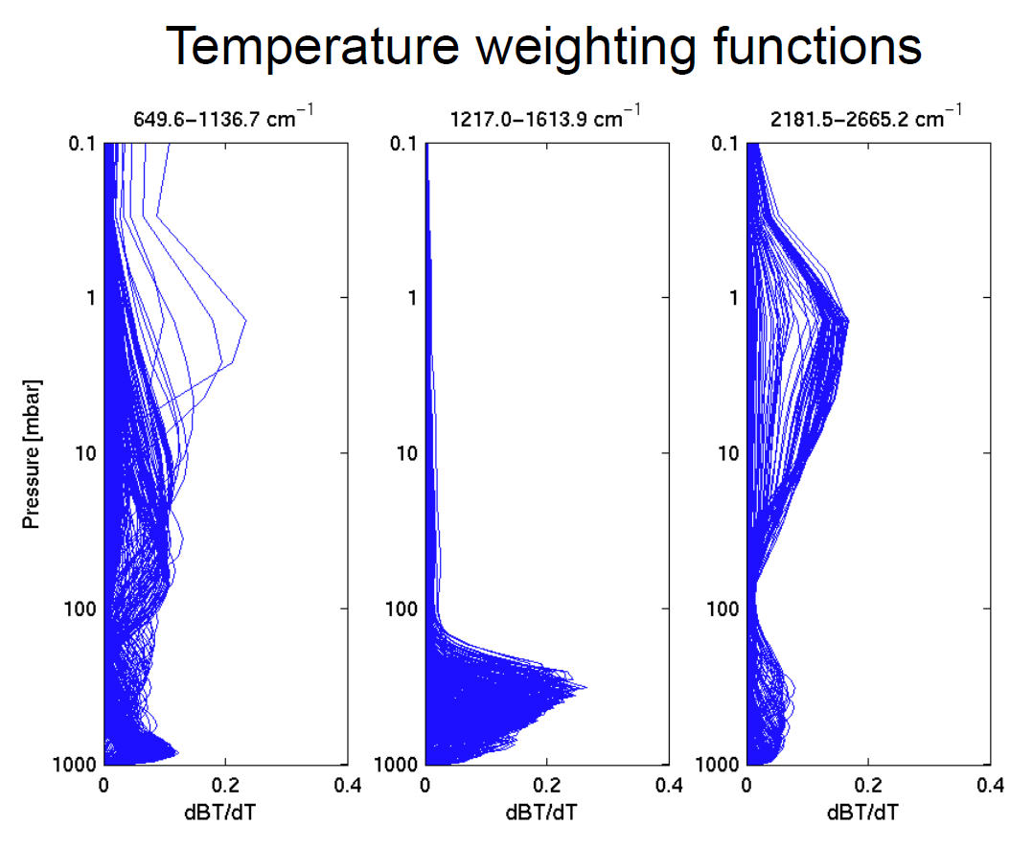
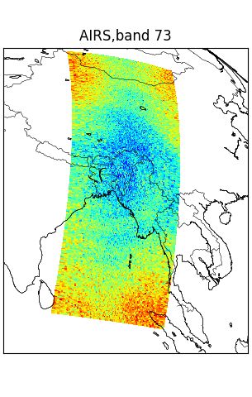
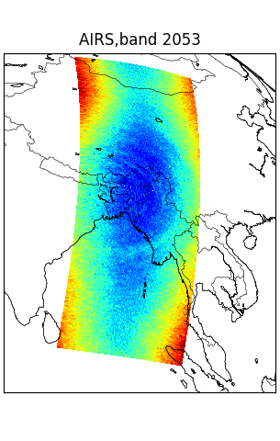
AIRS instrument (Atmospheric Infrared Sounder, Aqua satellite)
Bangladesh, 27 April 2014
General example of AIRS weighting functions (Jacobians)
source: AIRS Instrument Characteristics (available here)
EOS Aqua 19:35 UTC
EOS Aqua 19:35 UTC
27 April 2014, AIRS bands 73 and 2053.
For the 27 April 2014 case, CGW detected in bands 73 – 76 (14.986 – 14.969 µm) , and 2030 – 2060 (4.323 – 4.271 µm).
Martin Setvák (CHMI)

Slide 29
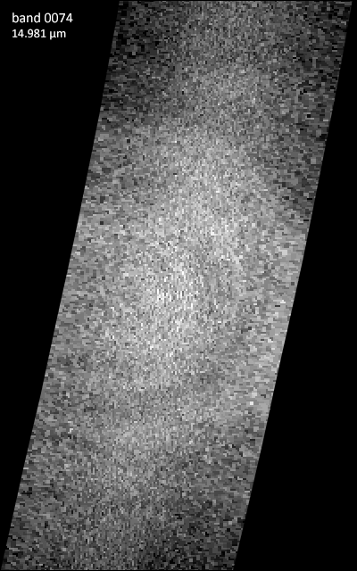
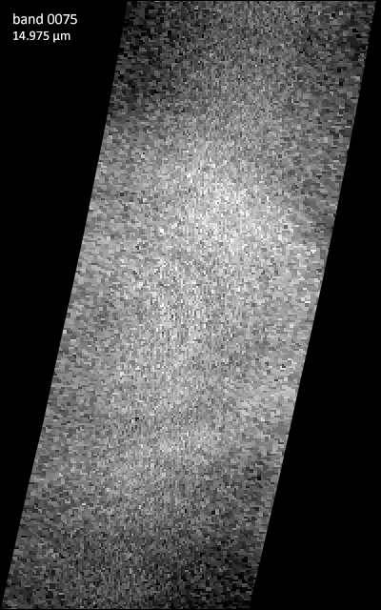
AIRS (Aqua, 19:35 UTC)
Bangladesh, 27 April 2014
Martin Setvák (CHMI)

Slide 30
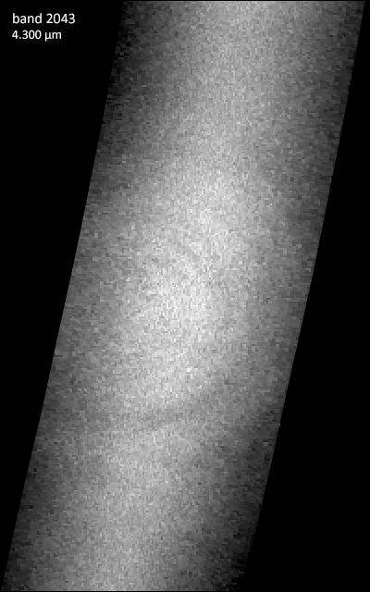
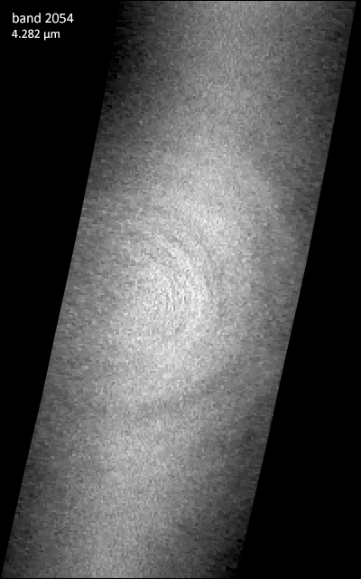
AIRS (Aqua, 19:35 UTC)
Bangladesh, 27 April 2014
Martin Setvák (CHMI)

Slide 31
AIRS (Aqua, 19:35 UTC)
Bangladesh, 27 April 2014
Martin Setvák (CHMI)

Slide 32
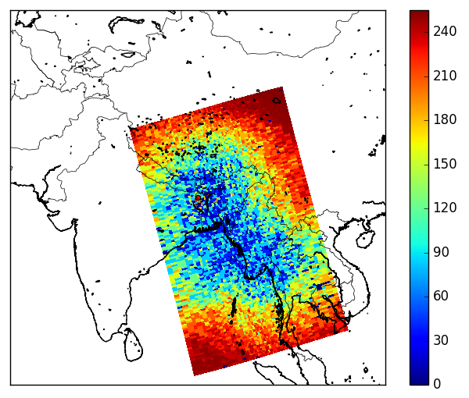
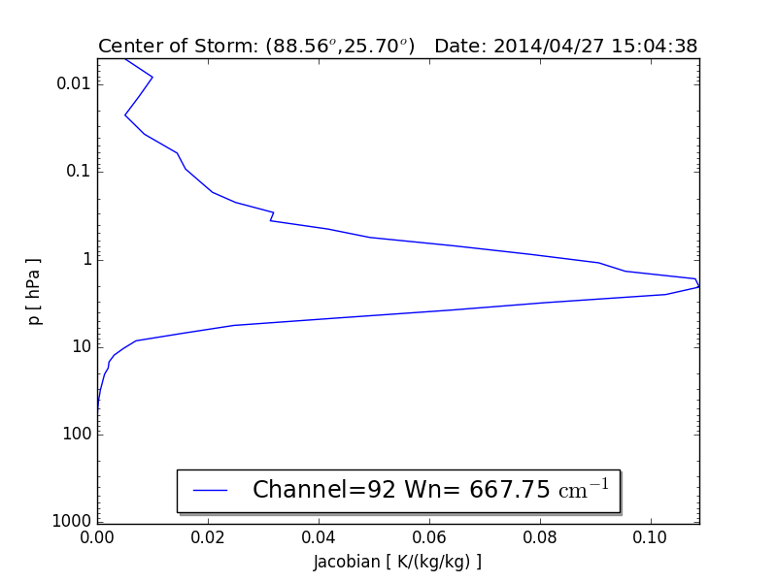
IASI – Infrared Atmospheric Sounding Interferometer, Metop 1, 2 & 3 satellites
Bangladesh, 27 April 2014
IASI swath width ~ 2200 km horizontal resolution 12 / 25 km
IASI band 92
IASI Metop-1, 27 April 2014 15:05 UTC, band 92 (14.976 µm).
Martin Setvák (CHMI)

Slide 33
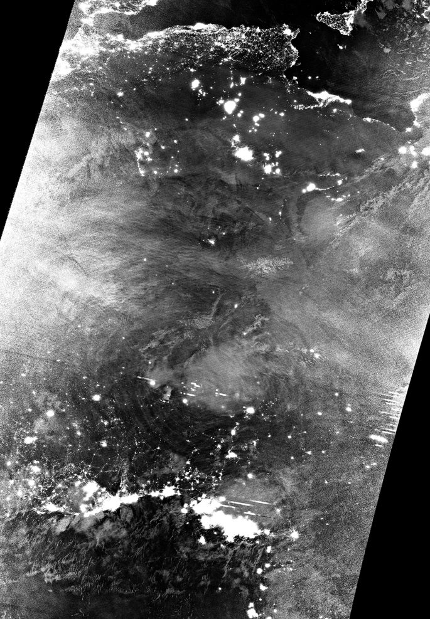
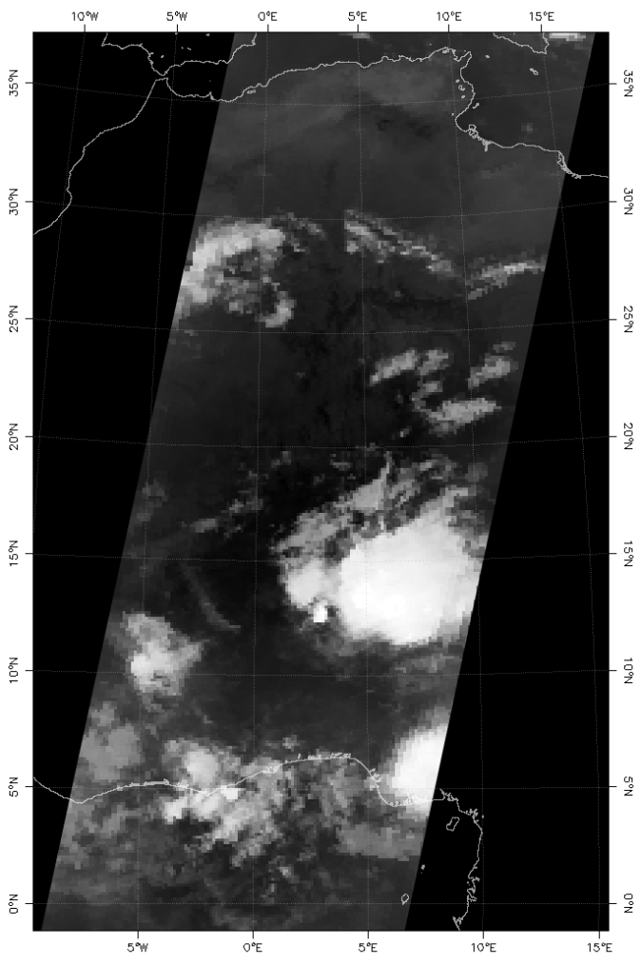
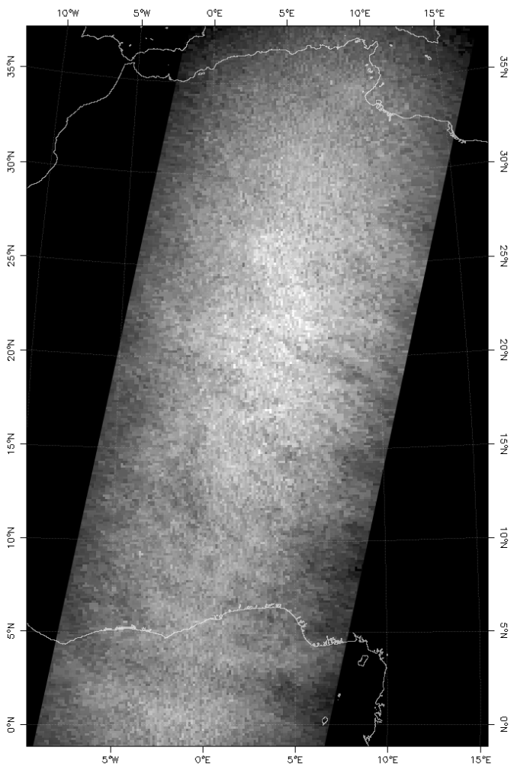
Example of weak concentric gravity waves in AIRS data
2018-06-16 01:36 UTC, Aqua AIRS, NW Africa
band 874
band 2054
2018-06-16 01:15 UTC, NOAA-20, DNB, NW Africa
Martin Setvák (CHMI)

Slide 34
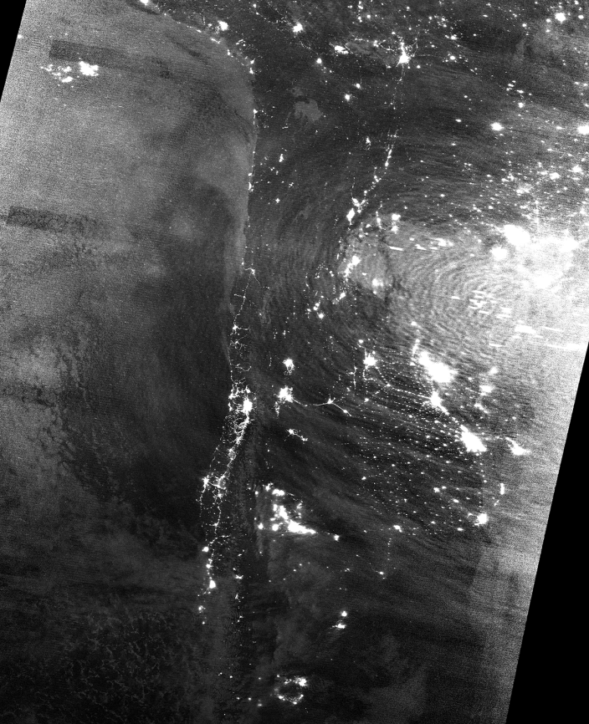
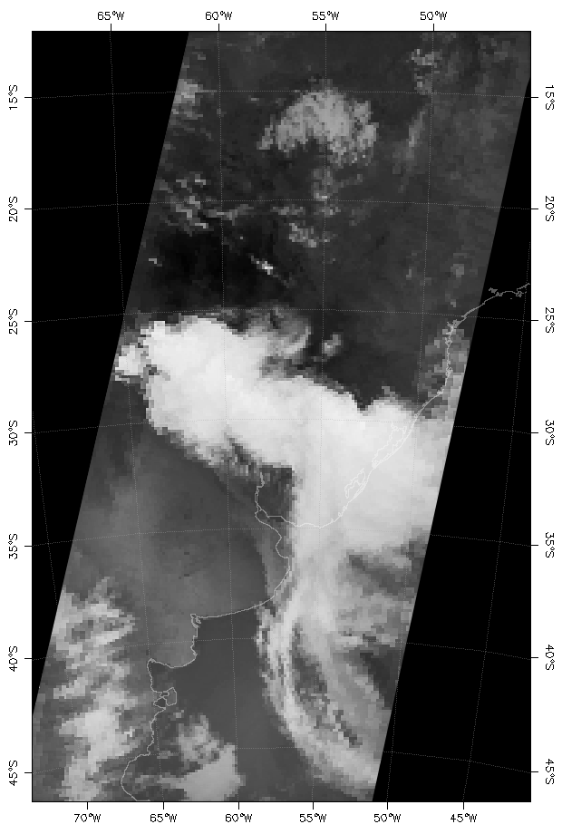
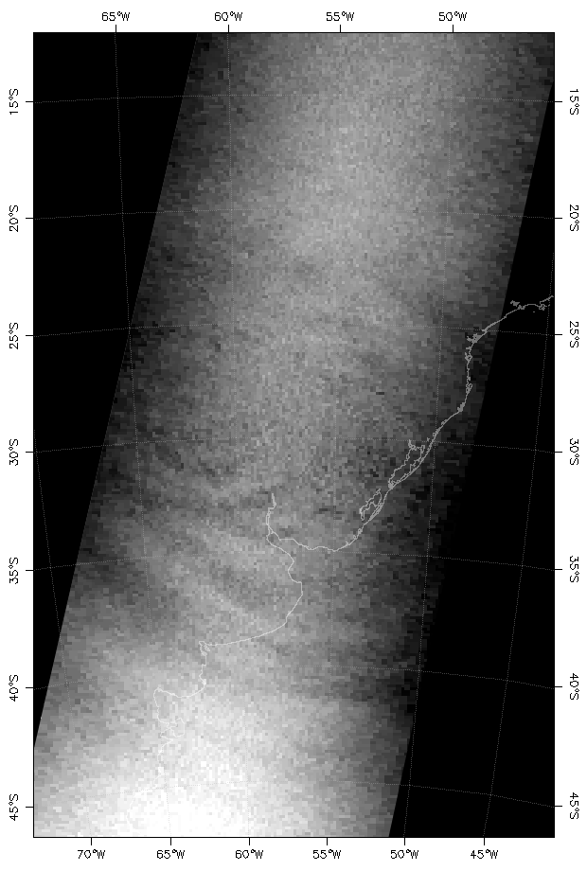
Other examples of (concentric) gravity waves in AIRS data
2017-10-19 05:05 UTC, Aqua AIRS, Argentina
band 874
band 2042
2017-10-19 05:43 UTC, S-NPP DNB, Argentina
Martin Setvák (CHMI)

Slide 35
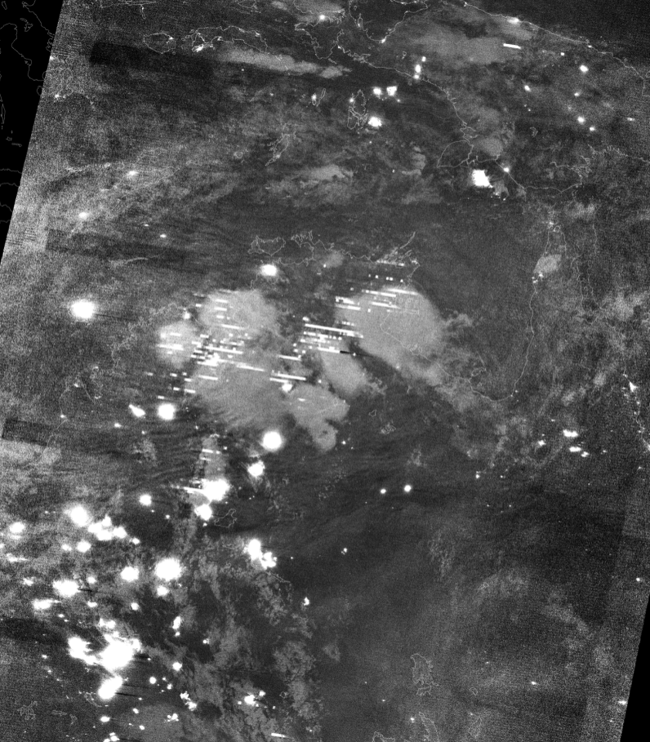
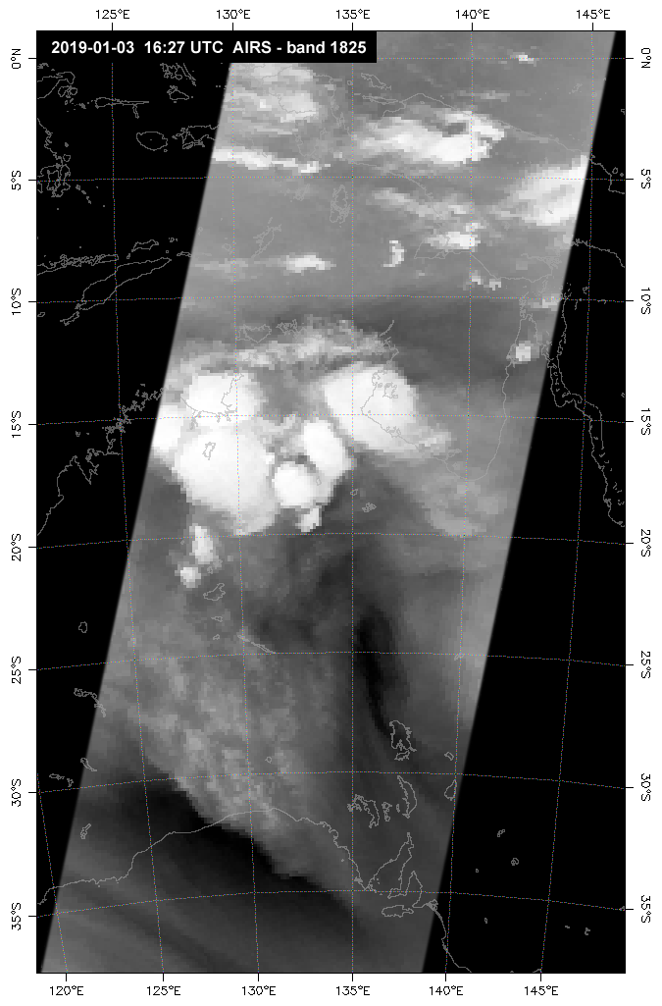
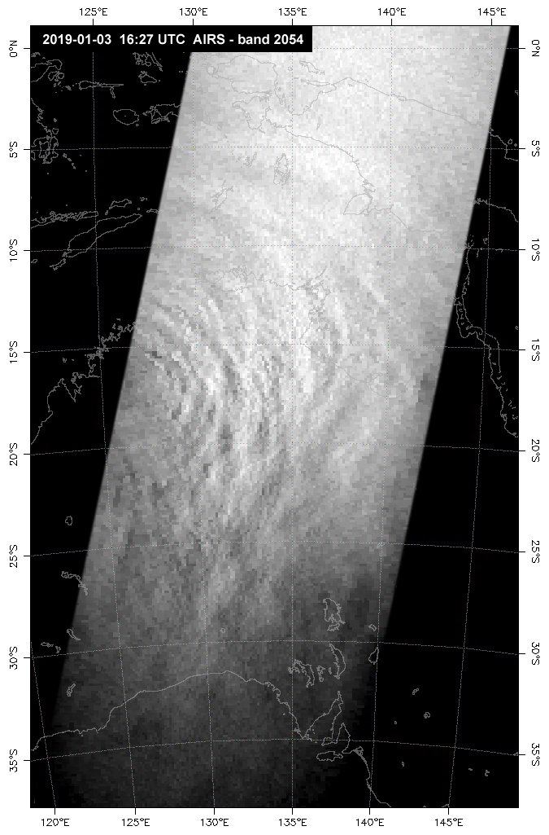
Other examples of (concentric) gravity waves in AIRS data
2019-01-03 16:27 UTC, Aqua AIRS, Australia
2019-01-03 16:20 UTC, S-NPP DNB, Australia
Martin Setvák (CHMI)

Slide 36
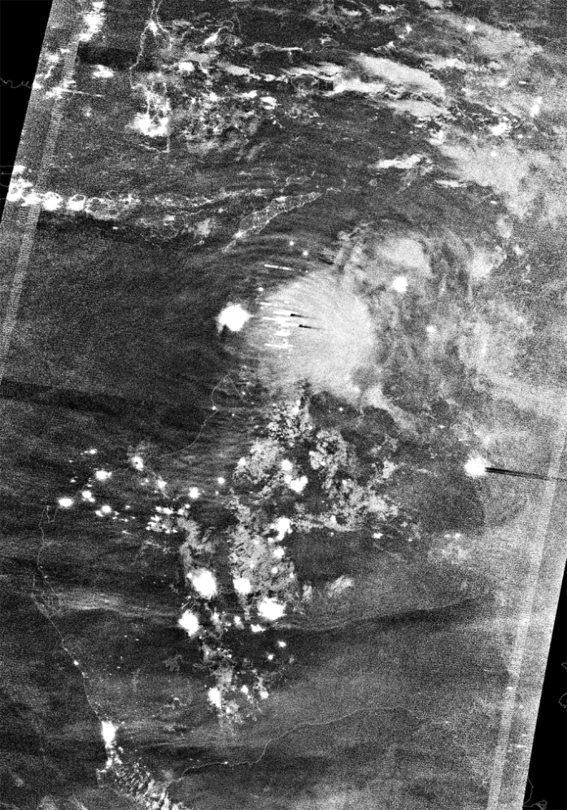
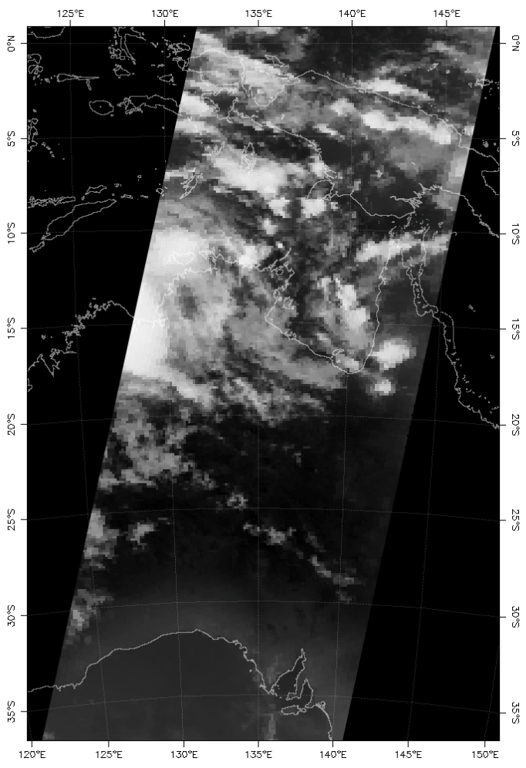
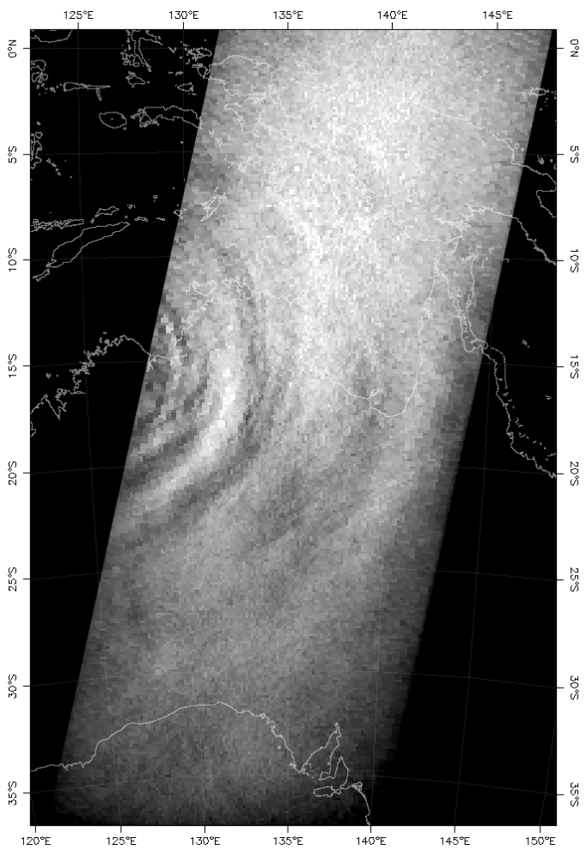
Other examples of (concentric) gravity waves in AIRS data
2019-01-12 16:22 UTC, Aqua AIRS, Australia
band 874
band 2054
2019-01-12 16:51 UTC, S-NPP DNB, Australia
Martin Setvák (CHMI)

Slide 37
CGW (and partial CGW) detections in nightglow in VIIRS DNB data (Suomi-NPP and NOAA-20)
REGION | 2013-2016 | 2017 | 2018 | 2019 | total:
Mediterranean region (including all coastal areas) | 4 | 2 | 4 | 3 | 13
Africa (including east Atlantic, west Indian ocean) | 24 | 19 | 14 | 16 | 73
North America and NE Pacific | 1 | 5 | 0 | 6 | 12
South America and SE Pacific | 0 | 2 | 3 | 0 | 5
Australia (and adjacent seas/oceans) | 0 | 1 | 6 | 5 | 12
East Asia (east of India, and adjacent seas/oceans) | 2 | 0 | 2 | 3 | 7
SW Asia (incl. India and Arab Peninsula, and adj. seas/ocean) | 1 | 4 | 1 | 3 | 9
total: | 32 | 33 | 30 | 36 | 131
CGW (and partial/semi-CGW) detections in AIRS data (obvious, strong)
REGION | 2013-2016 | 2017 | 2018 | 2019 | total:
Mediterranean region (including all coastal areas) | 0 | 0 | 0 | 0 | 0
Africa (including east Atlantic, west Indian ocean) | 3 | 2 | 1 | 2 | 8
North America and NE Pacific | 1 | 0 | 0 | 0 | 1
South America and SE Pacific | 0 | 1 | 0 | 0 | 1
Australia (and adjacent seas/oceans) | 0 | 0 | 0 | 3 | 3
East Asia (east of India, and adjacent seas/oceans) | 2 | 0 | 0 | 0 | 2
SW Asia (incl. India and Arab Peninsula, and adj. seas/ocean) | 1 | 0 | 0 | 1 | 2
total: | 7 | 3 | 1 | 6 | 17
CGW (and partial/semi-CGW) detections in AIRS data (likely present, weak)
REGION | 2013-2016 | 2017 | 2018 | 2019 | total:
Mediterranean region (including all coastal areas) | 0 | 0 | 0 | 1 | 1
Africa (including east Atlantic, west Indian ocean) | 5 | 3 | 1 | 2 | 11
North America and NE Pacific | 0 | 1 | 0 | 0 | 1
South America and SE Pacific | 0 | 0 | 1 | 0 | 1
Australia (and adjacent seas/oceans) | 0 | 0 | 2 | 0 | 2
East Asia (east of India, and adjacent seas/oceans) | 0 | 0 | 0 | 0 | 0
SW Asia (incl. India and Arab Peninsula, and adj. seas/ocean) | 0 | 0 | 0 | 0 | 0
total: | 5 | 4 | 4 | 3 | 16
 |  |  |  |  | total:
CGW in AIRS yes (total) | 12 | 7 | 5 | 9 | 33
CGW in AIRS no (total) | 16 | 16 | 15 | 24 | 71
AIRS data not available (total) | 4 | 10 | 10 | 3 | 27
Martin Setvák (CHMI)

Slide 38
Summary and final remarks
Total of cases with storm-generated CGW in DNB (2013-2019): 131 cases (up to 25 Oct 2019)
- all of these cases also checked for signatures of CGW in AIRS data
from these, AIRS data available for 104 cases
from these, only about 30% with some level of GW signatures in AIRS data, related to CGW in DNB
Outcome of this work:
first global survey of CGW in nightglow (???)
their link to AIRS data – no obvious correlation between strength of CGW in DNB/nightglow and AIRS (cases of weak CGW in DNB may show strong signatures in AIRS, and vice versa, cases of strong CGW in DNB/nightglow may not show even a trace of corresponding features in AIRS data)
AIRS band 2043, frequently used for GW observations, may not be the best one for this purpose, other bands (between ~ 2040 to 2060) sometimes show more clear CGW patterns
Future work:
continuation of this survey (as long as the EOS Worldview continues to provide the night-time DNB imagery, based on any of the NPP or JPSS satellites)
detailed analysis of selected cases, including Metop IASI data
Martin Setvák (CHMI)

Slide 39
Data sources, processing and acknowledgements
Satellite data sources (used within this study):
NASA EOSDIS Worldview – NPP DNB Nighttime global imagery
Suomi-NPP and NOAA-20 VIIRS data: NOAA CLASS archive
AQUA AIRS L1B data: NASA EarthData (data coverage here, direct data access here).
other satellite data and imagery: EUMETSAT
Satellite data processing:
VIIRS (DNB, I-bands and M-bands) data processed by ENVI software and its VCTK plug-in (by Devin White), final image processing done in Adobe Photoshop.
AIRS data visualized by ENVI software, additional image processing (selected cases) in Adobe Photoshop.
Support and acknowledgements:
This work has been partially supported by the CHMI research project „Dlouhodobá koncepce rozvoje výzkumné organizace (DKRVO) Český hydrometeorologický ústav na období 2018-2022”, financed by the Czech Ministry of Environment.
Martin Setvák (CHMI)

Slide 40
Additional slides
To be used for the discussion, if needed …
Martin Setvák (CHMI)

Slide 41
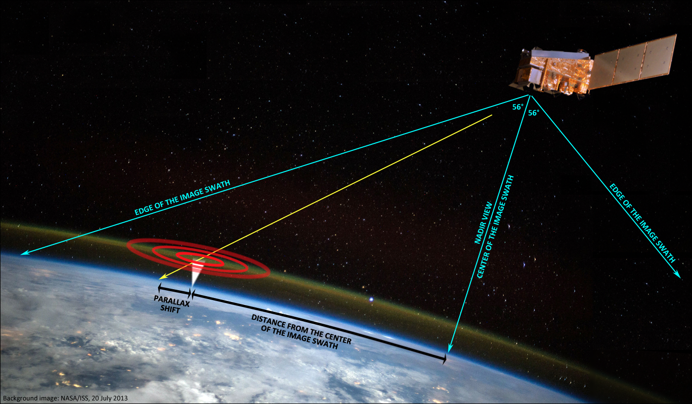
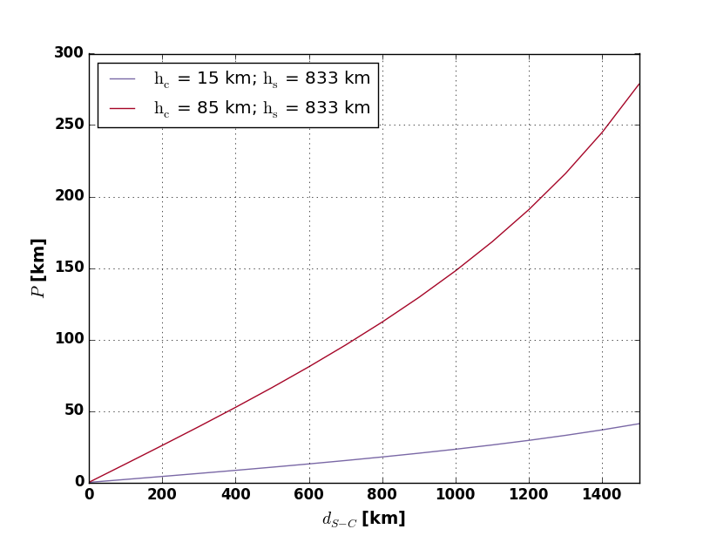
Parallax shift of the airglow features in VIIRS DNB imagery
Parallax shift versus distance from the center of the image swath
Parallax shift – apparent displacement of position of an object (feature) at higher altitude with respect to its real location above ground, resulting from a slant view from the satellite.
AIRGLOW (at 85 KM)
CLOUD TOPS OF STORMS (at 15 KM)
Parallax shift of airglow features in DNB imagery
Values of the parallax shift as related to distance from central line of the satellite data swath, computed for height 85 km and satellite orbit at 833 km.
Parallax shift values for cloud tops of convective storms at 15 km.
Plot above right and table:
Michaela Radová, michaela.radova@chmi.cz
Martin Setvák (CHMI)

Slide 42
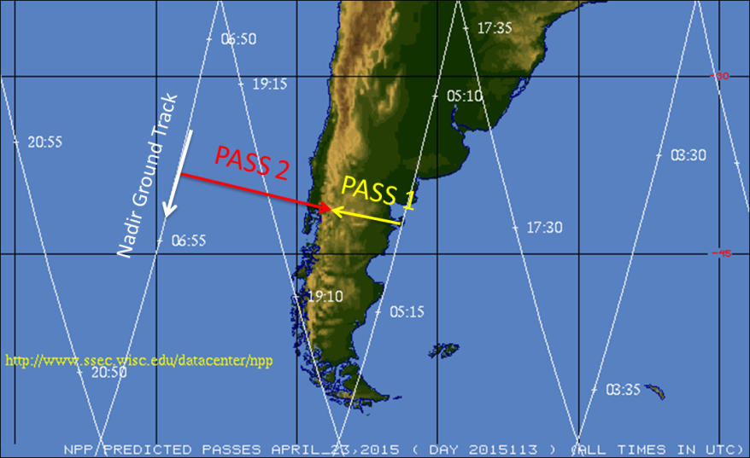
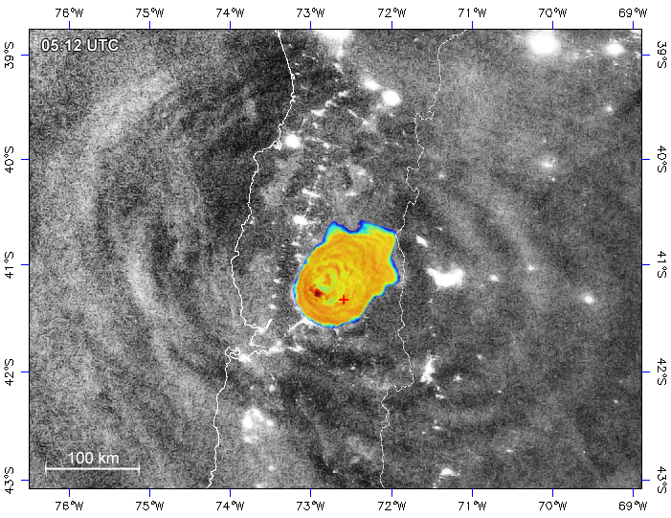
Parallax shift of the airglow features in VIIRS DNB imagery – Calbuco Volcano, 23 April 2015
Pass 1 (orbit #18058), 05:12 UTC
The Calbuco volcano region was relatively close to the track (nadir line) of the pass, therefore the parallax shift was rather moderate here.
+ – position of the Calbuco Volcano (from IR bands)
Martin Setvák (CHMI)

Slide 43
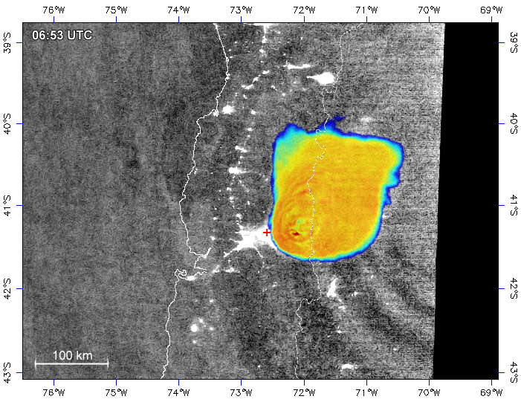
Parallax shift of the airglow features in VIIRS DNB imagery – Calbuco Volcano, 23 April 2015
250 km
Pass 2 (orbit #18059), 06:53 UTC
For this pass, the Calbuco volcano region was at the very edge of the image swath, therefore the parallax shift is substantial – for the center of the airglow waves about 250 km (in compliance with the calculated values).
Also, given the slant view from the west, the volcano itself can be seen in this pass – both in DNB (light emanated by the lava), and in IR bands (as a hot spot – not shown here).
+ – position of the Calbuco Volcano (from IR bands)
Martin Setvák (CHMI)

Slide 44
Examples of other , non-storm related (gravity) waves in nightglow and DNB observations:
Martin Setvák (CHMI)

Slide 45
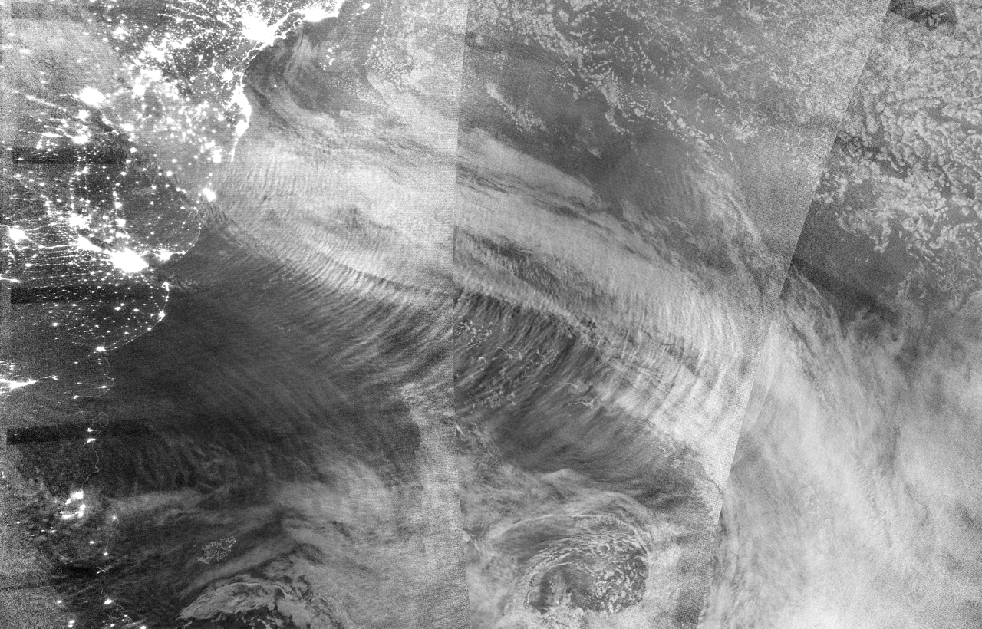
Nightglow in DNB imagery … waves generated by a jet stream, SW Atlantic Ocean, Argentina
2017-09-16
SNPP, ~ 01 - 04 UTC, SW Atlantic
Martin Setvák (CHMI)

Slide 46
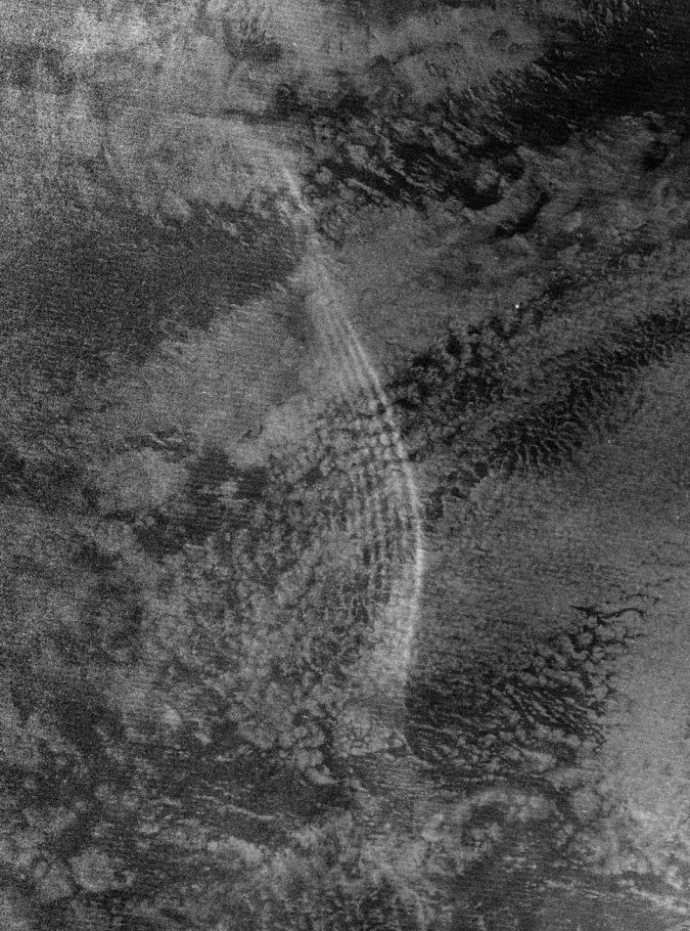
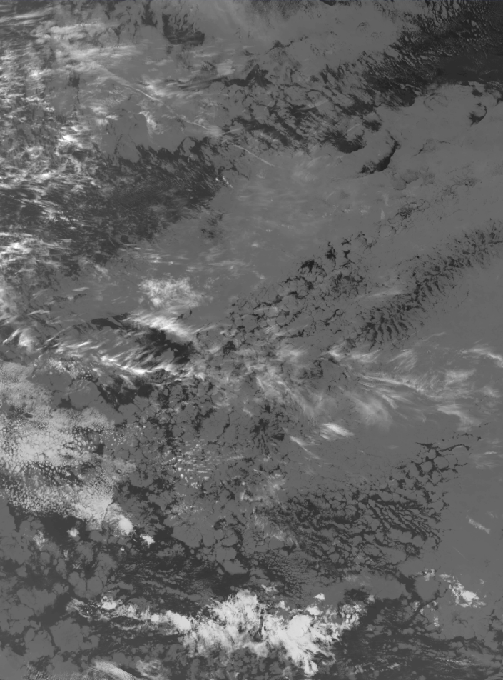
Bore waves in nightglow, central Atlantic Ocean
Suomi-NPP, 2017-10-19 02:15 UTC
DNB
IR M15
RGB Night-M
Martin Setvák (CHMI)

Slide 47
Concentric gravity waves in nightglow and DNB observations:
north-central and west Africa
Martin Setvák (CHMI)

Slide 48
Multiple concentric waves in nightglow above western Africa – 11 June 2015
2015-06-11 01:15 UTC
DNB
M15 BT (180-230K)
A complex of concentric gravity waves, generated by several storms in the area (several sources of the gravity waves), overlapping each other, spreading mainly north.
Martin Setvák (CHMI)

Slide 49
Multiple concentric waves in nightglow above western Africa – 11 June 2015
2015-06-11 01:15 UTC
DNB
M15 BT (180-230K)
and Night-M RGB
A complex of concentric gravity waves, generated by several storms in the area (several sources of the gravity waves), overlapping each other, spreading mainly north.
Martin Setvák (CHMI)

Slide 50
2015-06-11 01:15 UTC
DNB (detail)
Martin Setvák (CHMI)

Slide 51
Gravity waves in nightglow and DNB observations: northwest Africa
Area covering south Sahara, Sahel, and north tropics
strong convective storms forming in easterly waves
dark background with (almost) no light pollution
Martin Setvák (CHMI)

Slide 52
CGW in nightglow above Mauretania and Senegal – 6 September 2016
02:57 UTC VIIRS DNB
Martin Setvák (CHMI)

Slide 53
CGW in nightglow above Mauretania and Senegal – 6 September 2016
Cloud-top GW, 02:57 UTC, VIIRS band I5 (BT 177-207K, 375m)
02:57 UTC, VIIRS DNB & band I5 (BT 177-207K)
Martin Setvák (CHMI)

Slide 54
CGW in nightglow above Mauretania and Senegal – 6 September 2016
AIRS 02:20-02:30 UTC
band 1500
band 2042
Martin Setvák (CHMI)

Slide 55
11 April 2014 – gravity waves in nightglow, generated by convective storms east of Taiwan
Martin Setvák (CHMI)

Slide 56
11 April 2018
16:15 UTC S-NPP
and
17:05 UTC NOAA-20
Range of the waves:
up to about 2500 – 3000 km from their “parrent” storm;
but only within a limited, northeast to southeast sector.
Martin Setvák (CHMI)

Slide 57
11 April 2018 17:05 UTC – NOAA-20 (JPSS-1)
DNB and
IR M15-BT (197-240K)
Martin Setvák (CHMI)

Slide 58
11 April 2018 17:05 UTC – NOAA-20 (JPSS-1)
Night microphysics
RGB image product
Martin Setvák (CHMI)

Slide 59
11 April 2018 17:05 UTC – NOAA-20 (JPSS-1)
Wavelengths:
about 26 – 32 km
Martin Setvák (CHMI)

Slide 60
Martin Setvák (CHMI)

